Slide 1
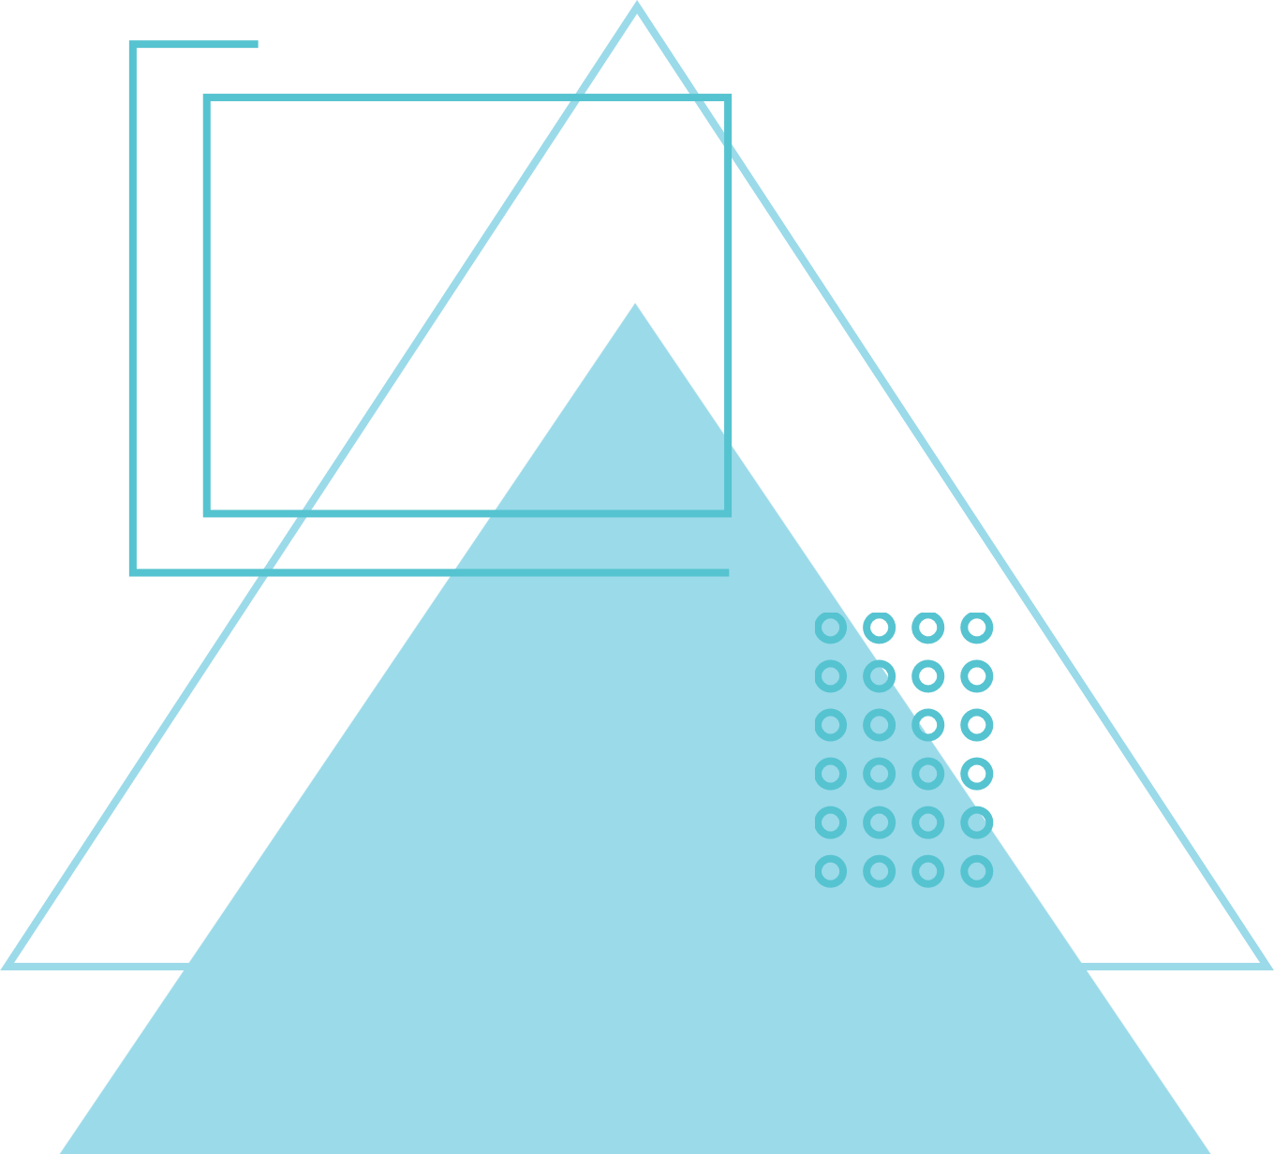
HAND GESTURE RECOGNITION SYSTEM AND SURVEY
By
Abhik Ghosh
E23CSEU0504
GitHub

Slide 2
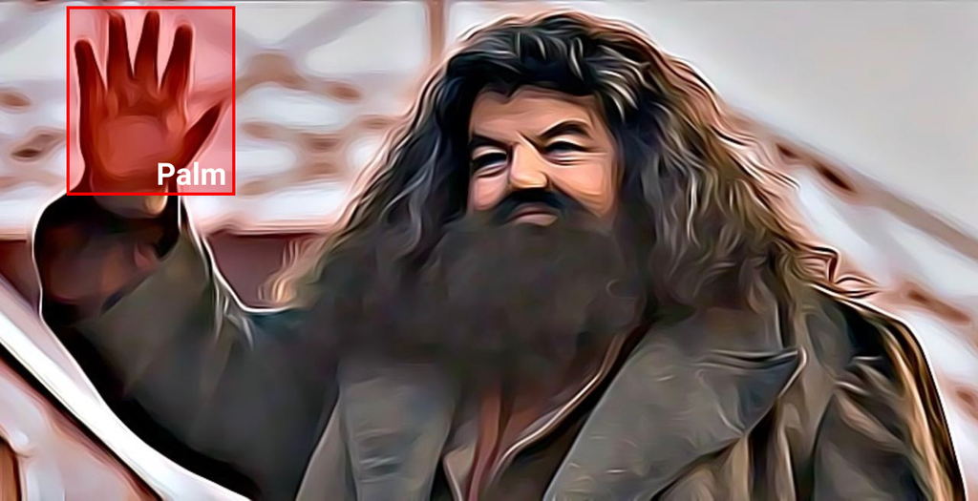
INTRODUCTION
Image classification is a fundamental task in computer vision with applications spanning autonomous vehicles, healthcare, and security systems. The development of deep learning models, particularly Convolutional Neural Networks (CNNs), has significantly improved classification accuracy. This report discusses an image classification project using a CNN architecture on the Hagrid 150k dataset, exploring existing research and external findings to contextualize and validate the approach.
This purpose of this project is to compare custom classification CNN architecture with standard models used for most research applications in this field and utilize a mobile app-based survey to find the perfect balance between complexity and accuracy for gesture recognition.

Slide 3
RELEATED WORK
SUMMARY
Previous work on hand gesture recognition has explored techniques ranging from traditional computer vision to machine learning and deep learning. This project aims to test the various approaches to classification
RESEARCH PAPERS
Research Paper 1
Research Paper 2
Research Paper 3

Slide 4
GOALS
AI/ML
DEPLOY AND SURVEY
Create and Train various AI models on the Hagrid Dataset
Including Custom Architecture and Well Known Architectures.
Deploy the AI models via an Android App and collect survey data about usefulness and accuracy of the various models.

Slide 5
METHODOLOGY
CREATION AND TRAINING
DEPLOYMENT
Architecture: CNN
Optimizer: Adam
LossFunction: SparseCategoricalCrossentropy
Epochs: 15
Batch Size: 128
Flutter
Android Studio
TFLite

Slide 6
CUSTOM MODELS

Slide 7
SIMPLE CNN
Architecture
Conv2D: 16 filters, activation 'relu', input shape (256, 256, 3)
MaxPooling2D: pool size 2x2
Conv2D: 32 filters, activation 'relu'
MaxPooling2D: pool size 2x2
Conv2D: 64 filters, activation 'relu'
MaxPooling2D: pool size 2x2
Dropout
Flatten
Dense: 128 units, activation 'relu'
Dense: 10 units, activation 'softmax'

Slide 8
COMPLEX CNN
Architecture
Conv2D(32, (3, 3), activation='relu', padding='same')
BatchNormalization()
MaxPooling2D((2, 2))
Dropout(0.25)
Conv2D(64, (3, 3), activation='relu', padding='same')
BatchNormalization()
MaxPooling2D((2, 2))
Dropout(0.25)
Conv2D(128, (3, 3), activation='relu', padding='same')
BatchNormalization()
MaxPooling2D((2, 2))
Dropout(0.25)
Flatten()
Dense(256, activation='relu')
BatchNormalization()
Dropout(0.5)
Dense(num_classes, activation='softmax', name="outputs")

Slide 9
EVALUATION
RESULTS

Slide 10
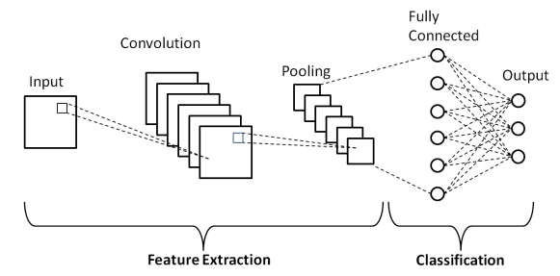
SIMPLE CNN
Simple CNN Metrics
Accuracy: 82%
Precision: 80%
Recall: 79%
F1-score: 80%
Simple Model Size
keras file: 96.4 MB
tflite: 32.1 MB

Slide 11
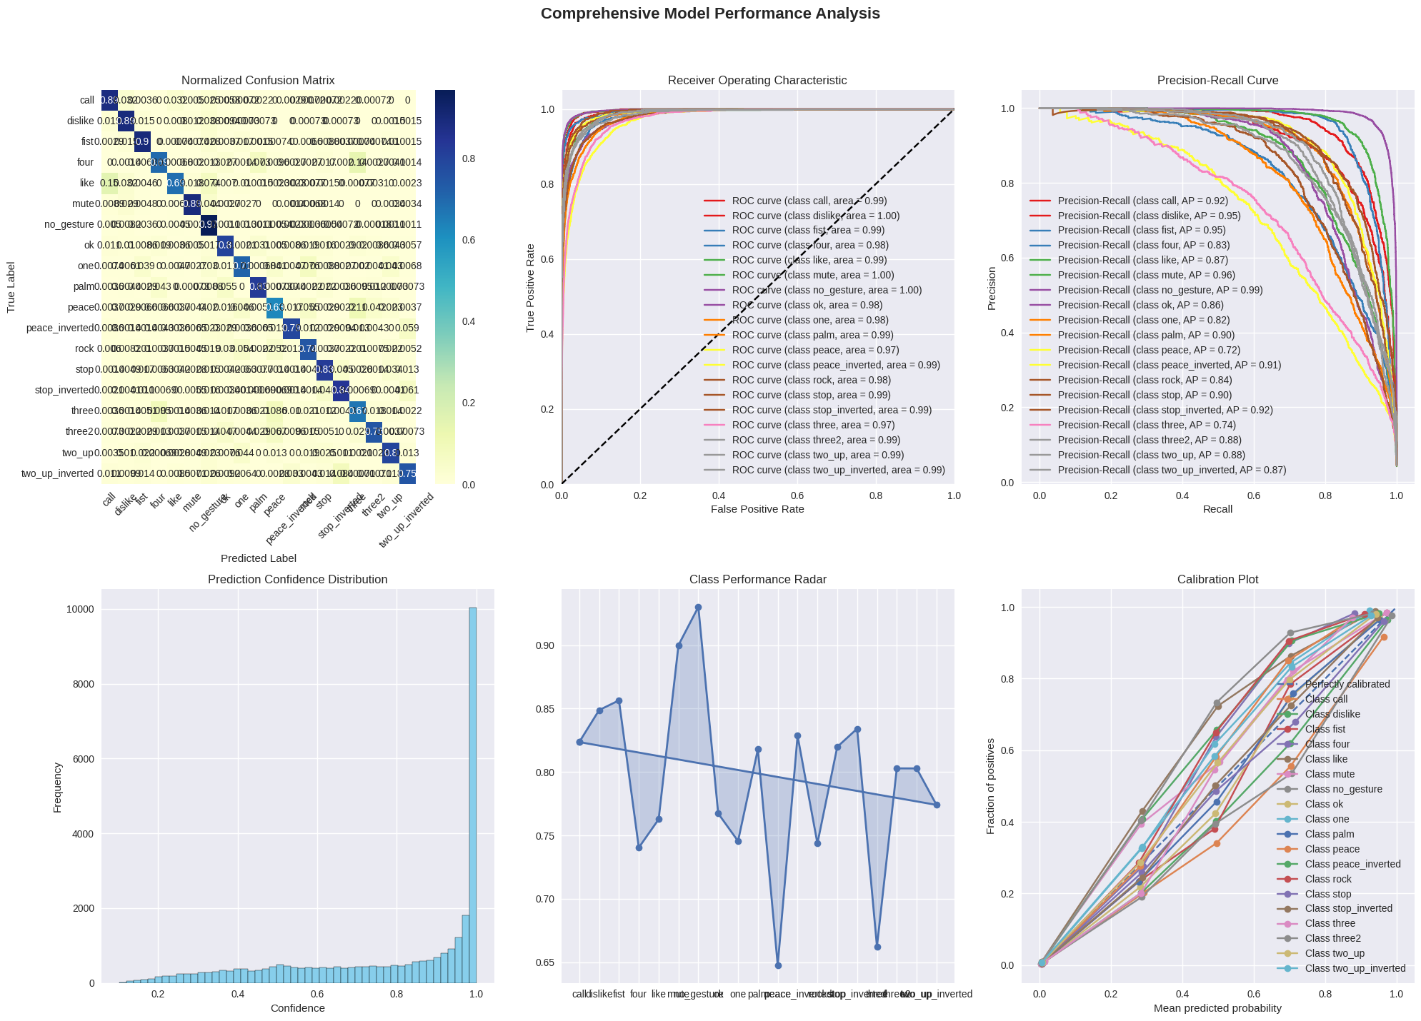
SIMPLE CNN GRAPHS

Slide 12
SIMPLE CNN GRAPHS

Slide 13
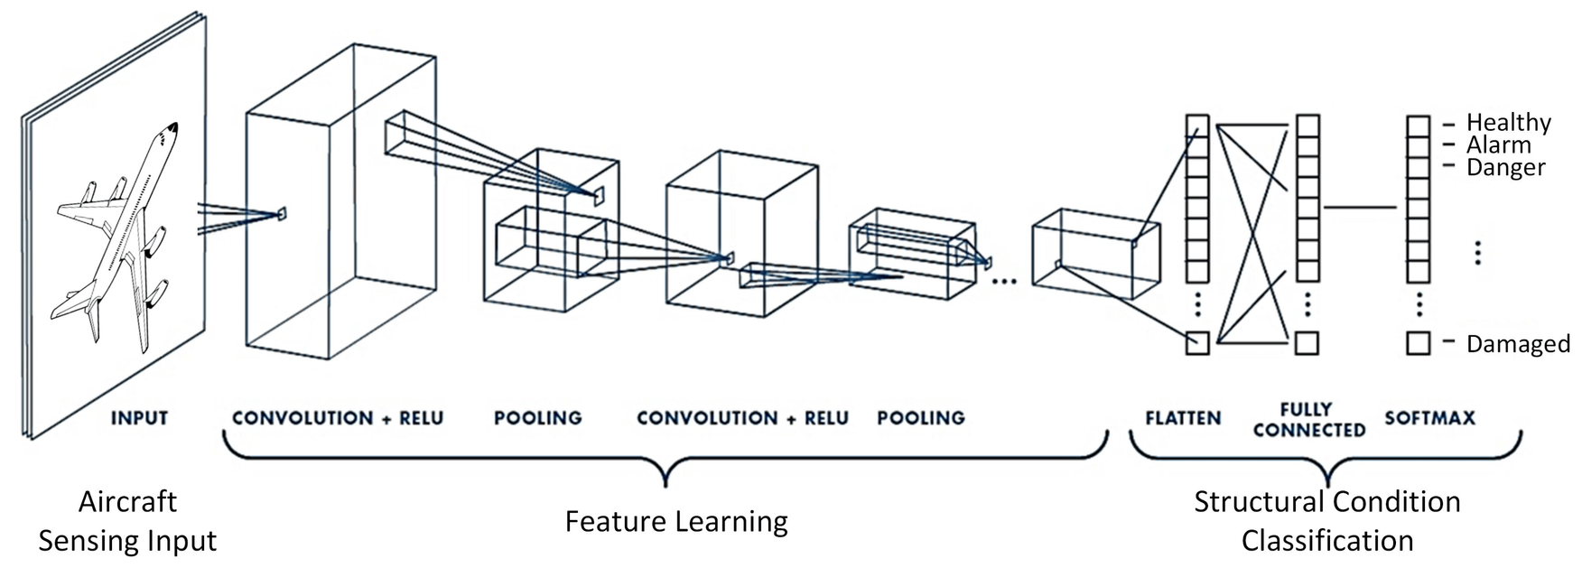
COMPLEX CNN
Complex CNN Metrics
Accuracy: 74%
Precision: 72%
Recall: 71%
F1-score: 71%
Complex Model Size
keras file: 385 MB
tflite: 128 MB

Slide 14
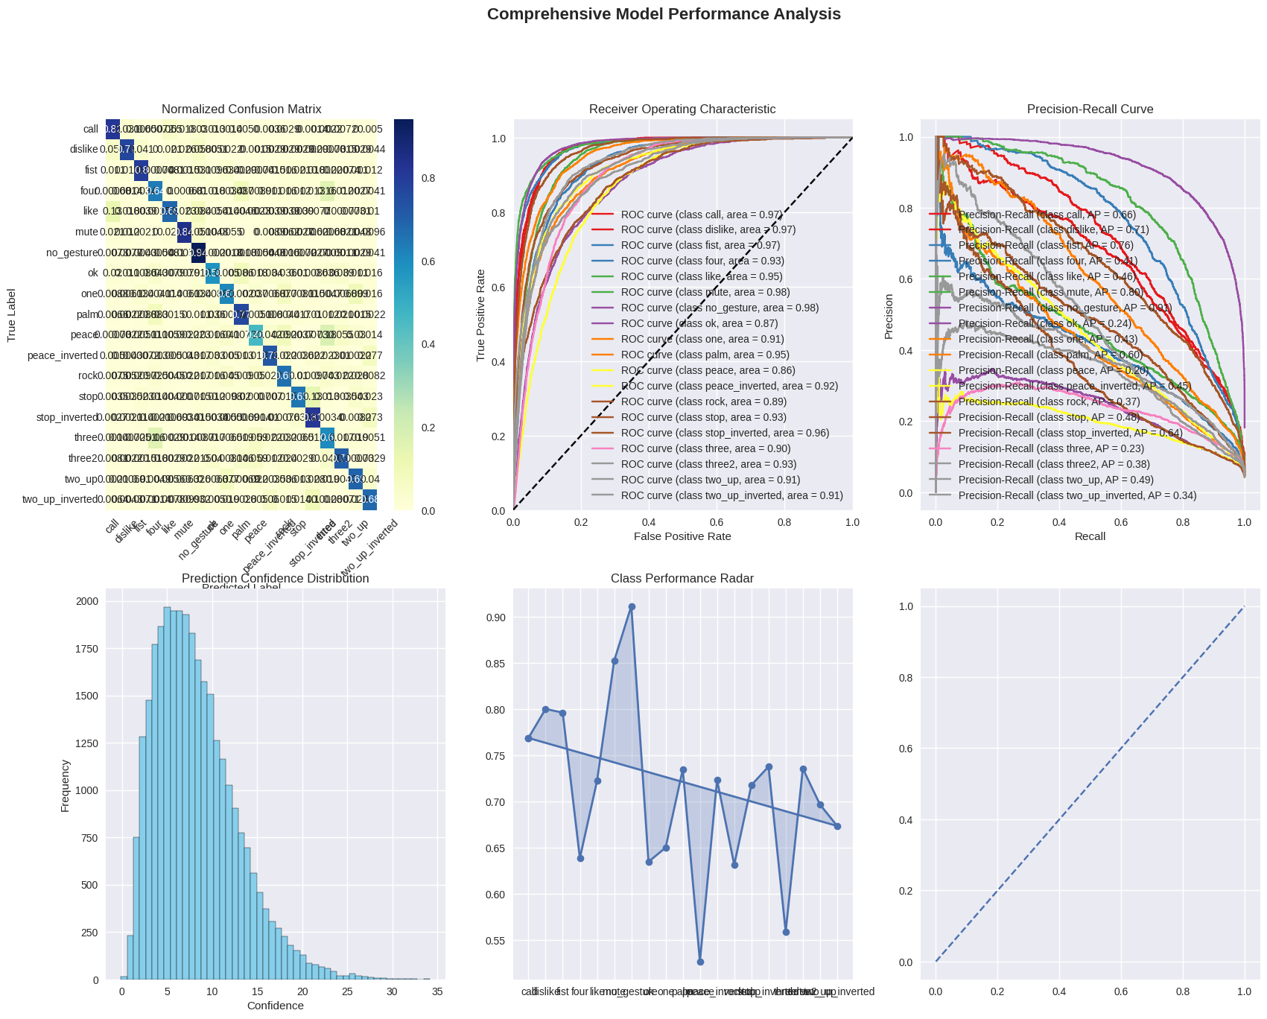
COMPLEX CNN GRAPHS

Slide 15
COMPLEX CNN GRAPHS

Slide 16
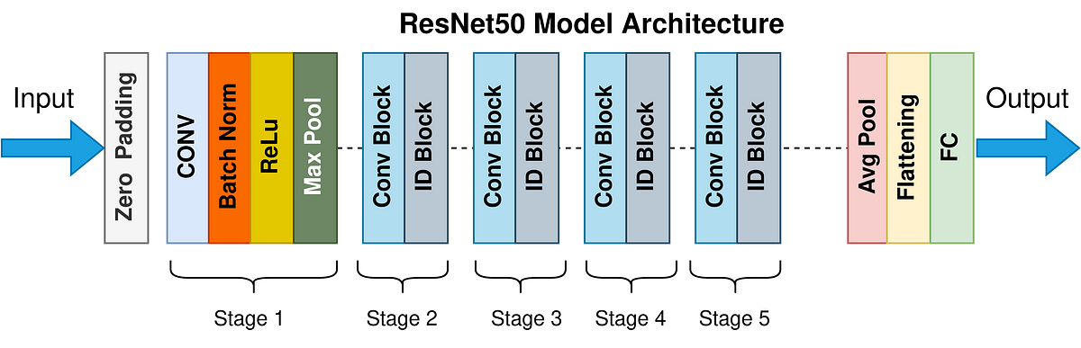
RESNET
Compareable ResNET50 Model
Accuracy: 93%
Precision: 93%
Recall: 92%
F1-score: 92%
ResNET50 Model Size
keras file: 271 MB
tflite: 89.8 MB

Slide 17
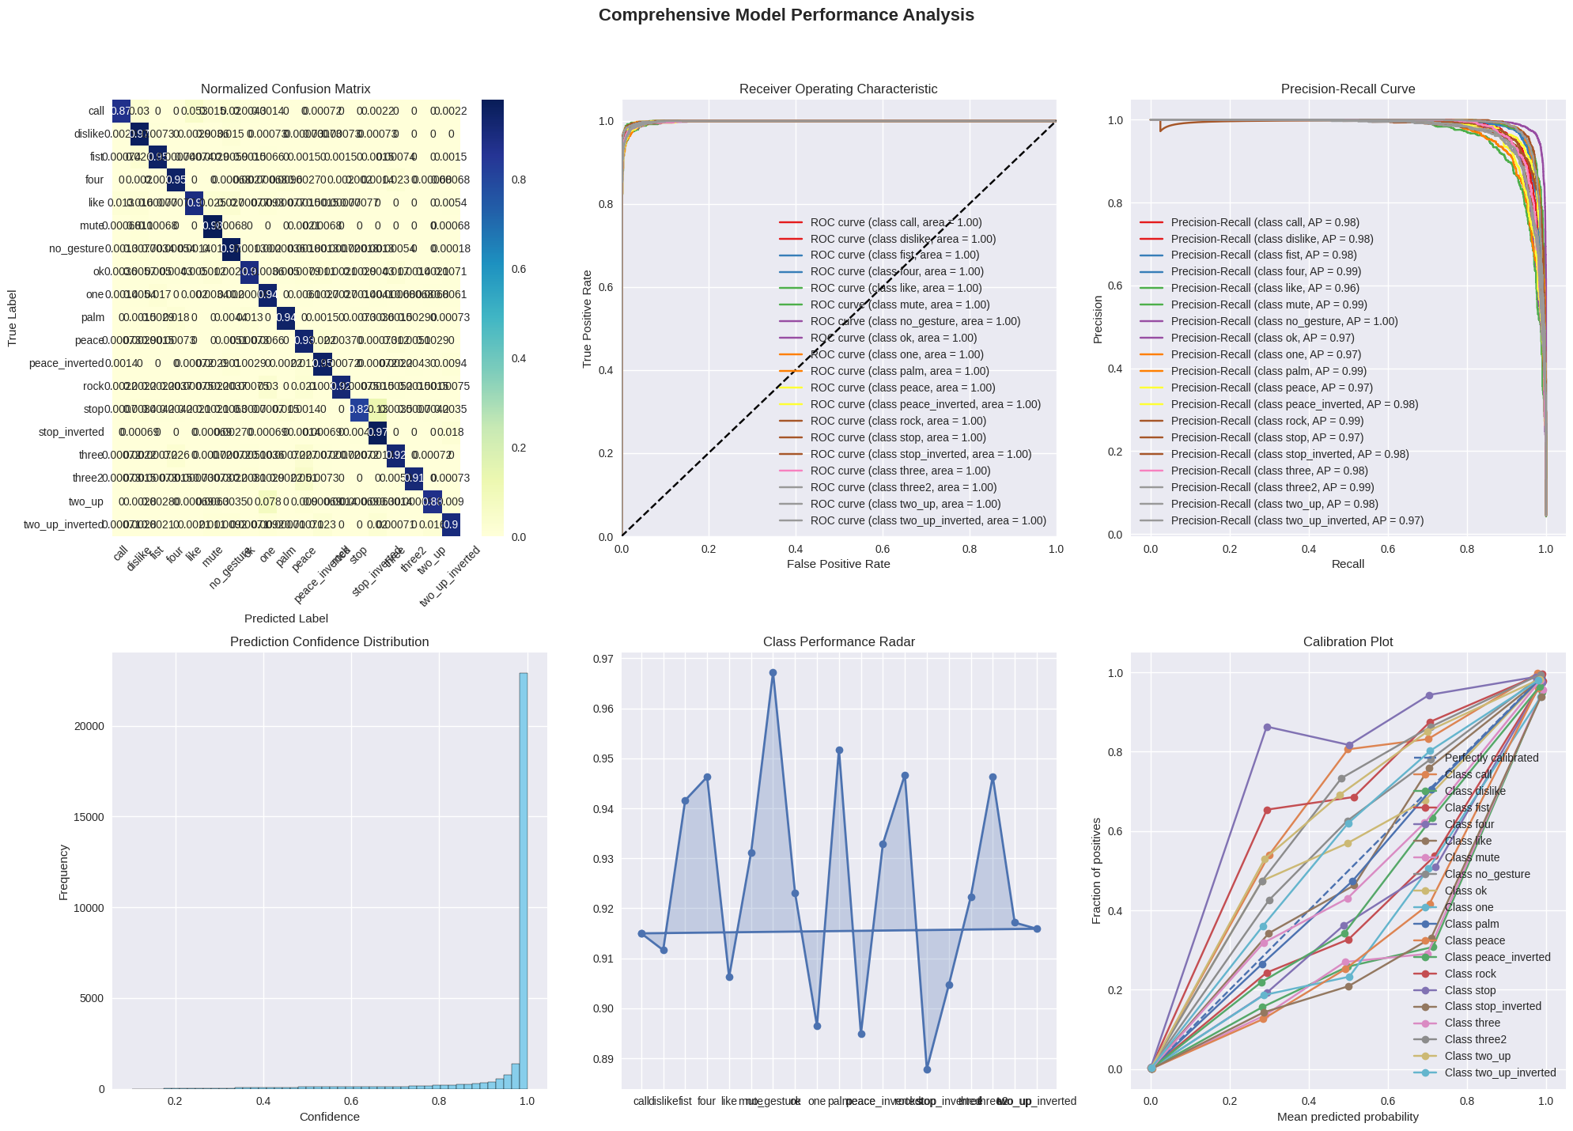
RESNET GRAPHS

Slide 18
RESNET GRAPHS

Slide 19

MOBILE APP
A Companion Mobile App to test and rate the Models built in flutter
Download Android App

Slide 20
FUTURE SCOPE
Future improvements could include:
Expanding the dataset to encompass more diverse gestures and environments.
Ability to load and benchmark User Made Models
Refining the Flutter app interface for enhanced user experience.
Incorporating advanced CNN architectures and hybrid deep learning models for better accuracy.
Exploring real-time gesture recognition capabilities for AR/VR applications.
Validating model performance over extended periods with a larger user base.

Slide 21
CONCLUSION
The project successfully demonstrates the use of CNN for hand gesture recognition. The user survey through the Flutter app hopes to establish a comprehensive evaluation of multiple models, highlighting the strengths and weaknesses of each.
Based on only validation Data the ResNET model proves to be the most promising architecture, we can use the survey data to confirm or deny this hypothesis.

Slide 22
THANK YOU
By
ABHIK GHOSH
E23CSEU0504
GitHub

